Slide 1
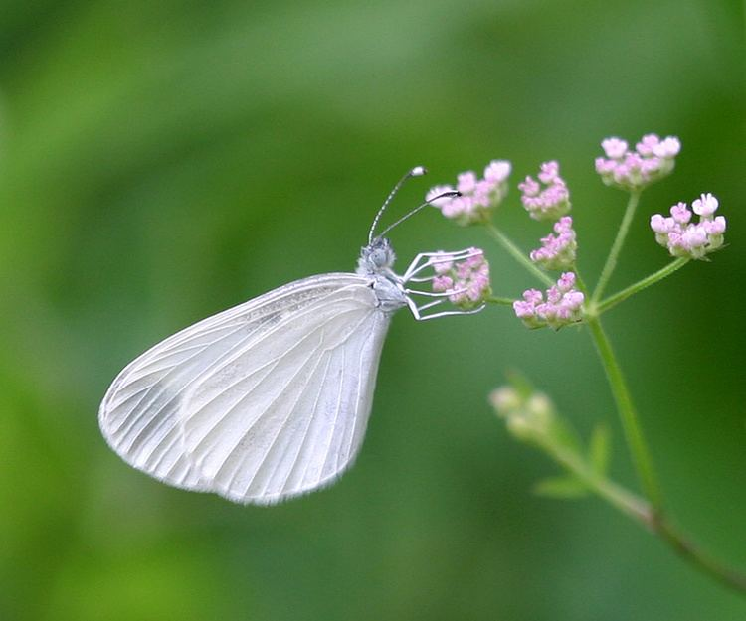
The Project
Study system: Leptidea sinapis (wood white)
To investigate host plant adaptation and effect in wood whites
Spanish population - Dorycnium pentaphyllum
Swedish population - Lotus corniculatus

Slide 2
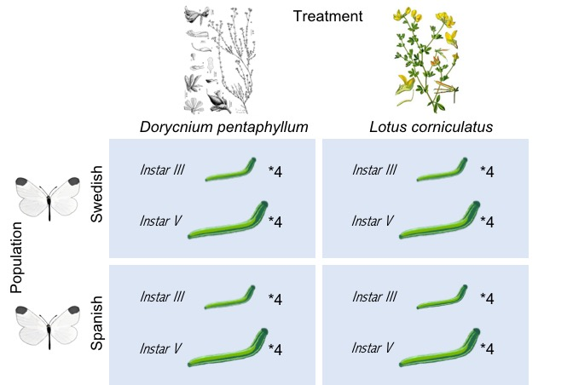

The Layout
Larvae of different populations fed on different host plants
Larval stage III and V from both males and females
Extracted RNA and DNA from body
Illumina sequencing of RNA
Differential gene expression for different treatments?

Slide 3
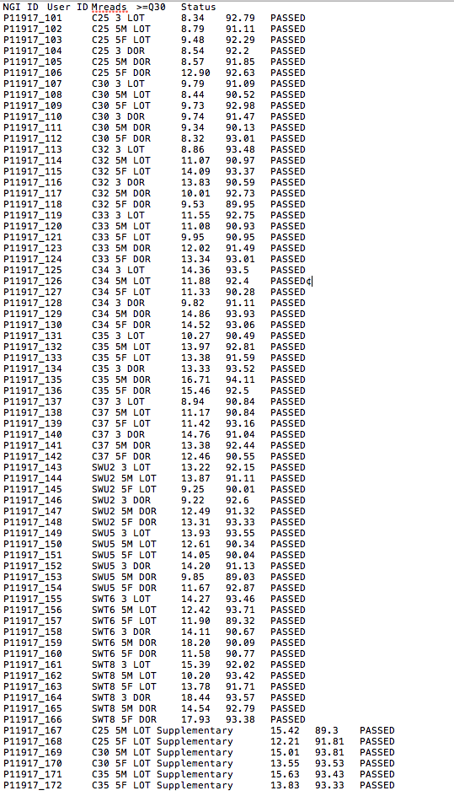
Sequencing output
Library – Illumina TruSeq Stranded mRNA. Option: Poly-A selection
Clustering – NovaSeq6000, S1 flowcell (one lane)
Paired-end, read length: 2 x 151bp
Output
Total nr of reads 936.28M
71 samples passed (1 sample aborted)
Reads per sample Average 12.33M (8.32-18.44M)
Coverage per gene 12.33 x 2 (240X per gene)
Quality All > 89% > Q30 (prob of error 1:1000)
Average 91.94% (89.03-94.11%)
GC-content Average 45% (37-49%)
Dupl Average 76.9% (60-89%)

